Slide 1

VIDEO TO AUDIO CONVERTER
Batch Members:
V ABHIRAM (2010030180)
ROKKAM VIVEK VARDHAN REDDY (2010030142)
K SIDHARTH RAO (2010030443)
A RAGHAVENDRA GOUD (2010030394)
Supervisor
CHANDARAJ KUMAR SIR

Slide 2
Abstract
The project video to audio converter is all about converting a mp4 file to mp3 file.
We will need a video recording for this project. It can even be a recording of yourself speaking to the camera.
Using a library called MoviePy, we will extract the audio from the video recording.
We need to give the input as video and we get output as audio.

Slide 3
Introduction
Converting Video to audio files is a smart tool to extract audio from video files.
We will take you through a simple program to build a video to audio converter with Python programming language.
It is used to extract audio from the a desired video where in we are just interested in just audio.

Slide 4
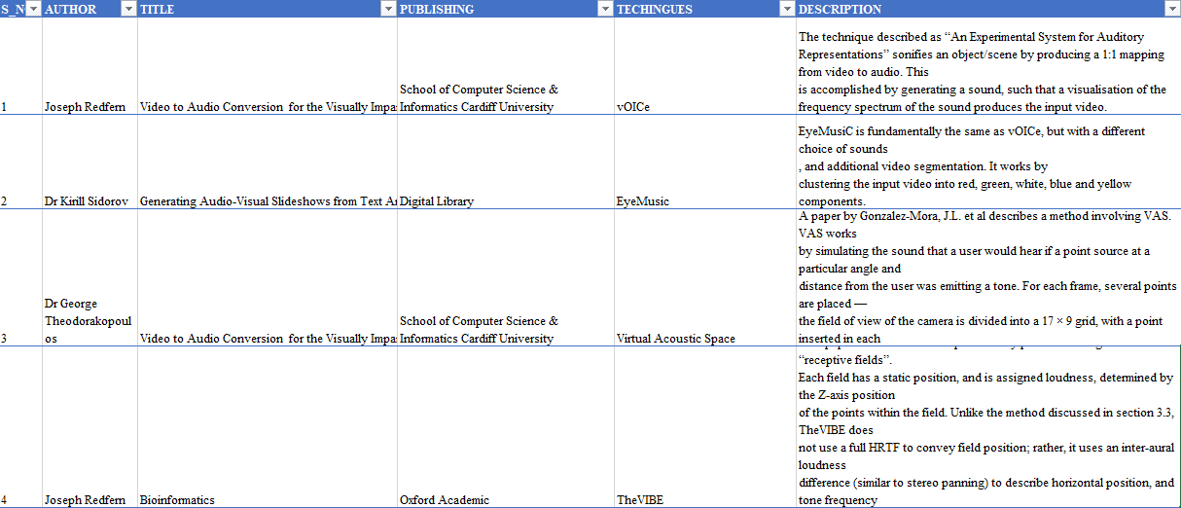
Literature Survey

Slide 5
Existing System
In the existing systems, there will be a limitation with respect to the quality of the video which is converted, i.e, only high quality videos will be converted to audio format.

Slide 6
Proposed System
In the propose systems, there will be no limitation with respect to the quality of the video which is converted, i.e, videos of all quality will be converted to audio format.

Slide 7
Methodology
Tkinter
The tkinter package (“Tk interface”) is the standard Python interface to the Tcl/Tk GUI toolkit. Both Tk and tkinter are available on most Unix platforms, including macOS, as well as on Windows systems
os:
The OS module in Python provides functions for creating and removing a directory (folder), fetching its contents, changing and identifying the current directory, etc.

Slide 8
moviepy:
MoviePy is a Python library for video editing: cutting, concatenations, title insertions, video compositing (a.k.a. non-linear editing), video processing, and creation of custom effects
PIL:
Pillow is the friendly PIL fork by Alex Clark and Contributors. PIL is the Python Imaging Library by Fredrik Lundh and Contributors. As of 2019, Pillow development is supported by Tidelift.

Slide 9
Algorithm/Techniques/Tools Used
Movie Editor:
Movie Editor is a Python module for editing videos. It can cut and arrange clips, add video effects, and edit audio. It can work like a toolbox, if you only make changes to one clip. If you have to edit lots of clips, Movie Editor can automate that process.

Slide 10
Software and Hardware Requirements
HARDWARE:
Modern Operating System:
Windows 7 or 10
Mac OS X 10.11 or higher, 64-bit
Linux: RHEL 6/7, 64-bit (almost all libraries also work in Ubuntu)
x86 64-bit CPU (Intel / AMD architecture)

Slide 11
SOFTWARE:
Python3
Pycharm community(IDE)

Slide 12
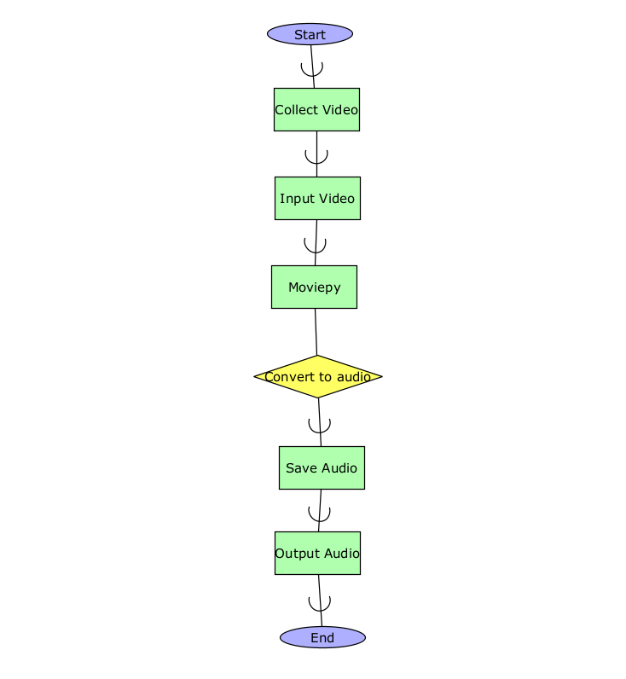
Block Diagram/Architecture

Slide 13
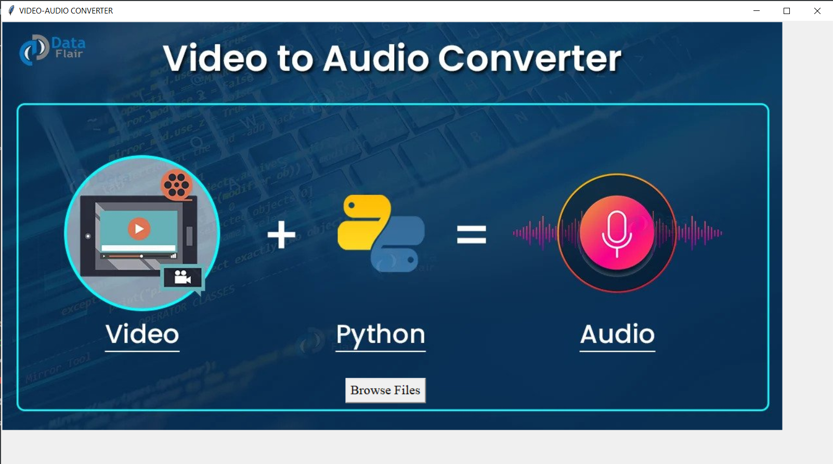
Results

Slide 14
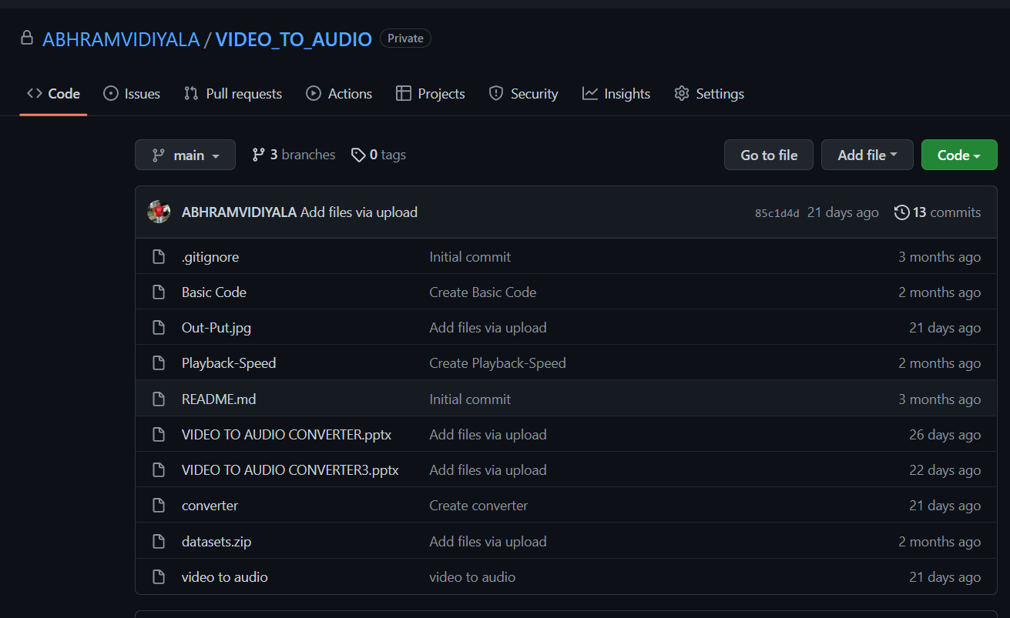
Github Setup

Slide 15
Applications
In cases where we just need the audio file, but not the entire video, we can use this application.
This will also enable us to save the memory by not saving the video file, which is usually of high memory.

Slide 16
Conclusion
Thus, by following the above technique, we can convert a mp4 file into an mp3 file. In the cases where we will need only the audio in the video files, we can use this technique to extract and save the audio file, which will help in saving the memory too. Here, the user will have the comfort of selecting his desired vedio, and can convert it into audio form.

Slide 17
Converting a video to audio has many advantages and is very useful in our amateur learning. The above-mentioned technique can be used in achieving this. But when you want to convert some videos containing sensitive information, desktop applications that can work without a network would be a better choice.
It will not upload your videos to its service and change the file format by offline transcoding.

Slide 18
Future Scope
We can convert the video to text format .
We can convert from video to audio and then audio to text .

Slide 19
References
https://data-flair.training/blogs/python-video-to-audio-converter/
https://www.geeksforgeeks.org/video-to-audio-convert-using-python/
https://thecleverprogrammer.com/2020/12/08/video-to-audio-converter-with-python/
https://towardsdatascience.com/extracting-audio-from-video-using-python-58856a940fd?gi=e3a07ef57d
https://www.krazyprogrammer.com/2021/01/video-to-audio-converter-in-python-with.html

Slide 20
Thank You

